Slide 1

ROCKBUSTER STEALTH LLC
BUSINESS BREAKDOWN
DECEMBER 2022
Presented by: Rachel

Slide 2

ROCKBUSTER STEALTH LLC
2020 PLANNING STRATEGY
EXISTING LICENSES FOR FUTURE STREAMING SERVICES
KEY QUESTIONS:
Which movies contributed the most/least to revenue gain?
What was the average rental duration for all videos?
Which countries are Rockbuster customers based in?
Where are customers with a high lifetime value based?
Do sales figures vary between geographic regions?

Slide 3


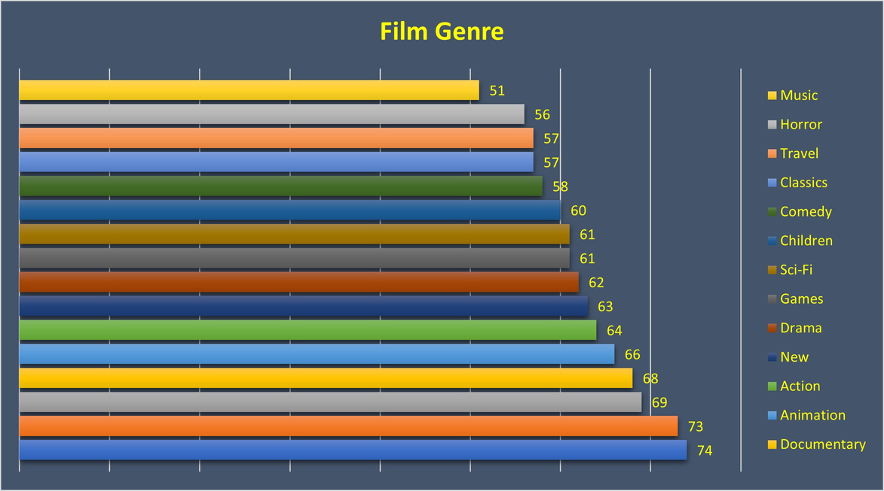
BUSINESS OVERVIEW
Largest
Genre
Inventory
Animation
Top Rental
Country
India
Top Genre
Rented:
PG-13
Average
Rental Duration
5 days
108
Countries
Serviced
Average Rental
$2.98

Slide 4



Top 20 Rentals with Rating
Telegraph Voyage PG 215.75
Zorro Ark NC-17 199.72
Wife Turn NC-17 198.73
Innocent Usual PG-13 191.74
Hustler Party NC-17 190.78
Saturday Lambs G 190.74
Titans Jerk PG 186.73
Harry Idaho PG-13 177.73
Torque Bound G 169.76
Dogma Family G 168.72
Pelican Comforts PG 165.77
Goodfellas Salute PG 164.75
Fool Mockingbird PG 162.79
Apache Divine NC-17 160.72
Enemy Odds NC-17 159.75
Cat Coneheads G 159.73
Scorpion Apollo NC-17 158.79
Range Moonwalker PG 158.77
Scalawag Duck NC-17 157.71
Sunrise League PG-13 155.78
Lowest 20 Rentals with Rating
Duffel Apocalypse G 5.94
Texas Watch NC-17 5.94
Oklahoma Jumanji PG 5.94
Freedom Cleopatra PG-13 5.95
Young Language G 6.93
Rebel Airport G 6.93
Treatment Jekyll PG 6.94
Cruelty Unforgiven G 6.94
Lights Deer R 7.93
Japanese Run G 7.94
Stallion Sundance PG-13 7.94
Ghostbusters Elf R 8.93
Harold French NC-17 8.93
Connection Microcosmos G 8.95
Ballroom Mockingbird G 9.93
Comancheros Enemy R 9.94
Towers Hurricane NC-17 10.91
Jawbreaker Brooklyn PG 10.91
Zhivago Core NC-17 10.93
Maude Mod R 10.93

Slide 5

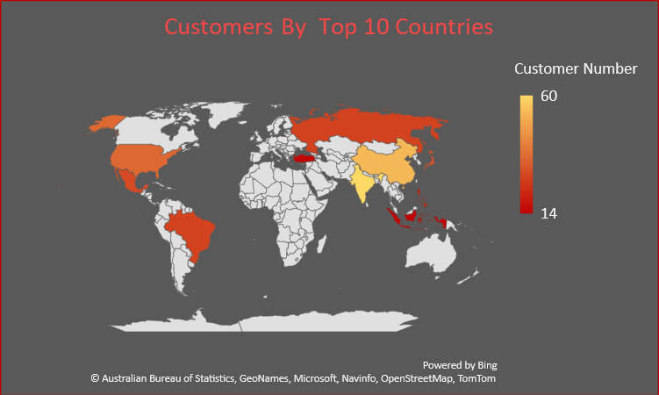
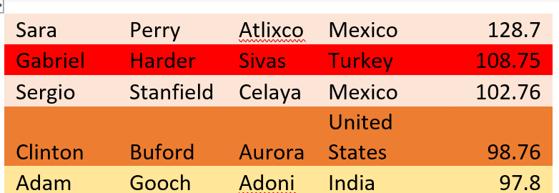
Russia
USA
China
India
Brazil
TOP 5 Customers & Location

Slide 6


Business Summary
Average Rental Cost $2.98
Average Rental Duration 5 days
Top 3 Genres Rented PG-13, NC-17, PG
Asia has the overall highest profits/Largest number of members
3 of top 5 rentals are NC-17/ 2 of lowest 5 rentals are rated G

Slide 7
Business Recommendations
Look at the overall inventory
Decrease or cancel lowest sale titles if paying for licenses
Focus future licensing on highest genre sales
Are there popular titles that need a higher inventory
Consider Customers
Possible rewards for loyalty
Referral rewards to grow customers
Are we meeting the cultural needs of films in the highest rental countries

Slide 8
THANK YOU
ANY QUESTIONS?
RACHEL
RJHBLUME@AOL.COM

